Slide 1

Hospital Translator
Priscilla, Maham, Kofi

Slide 2
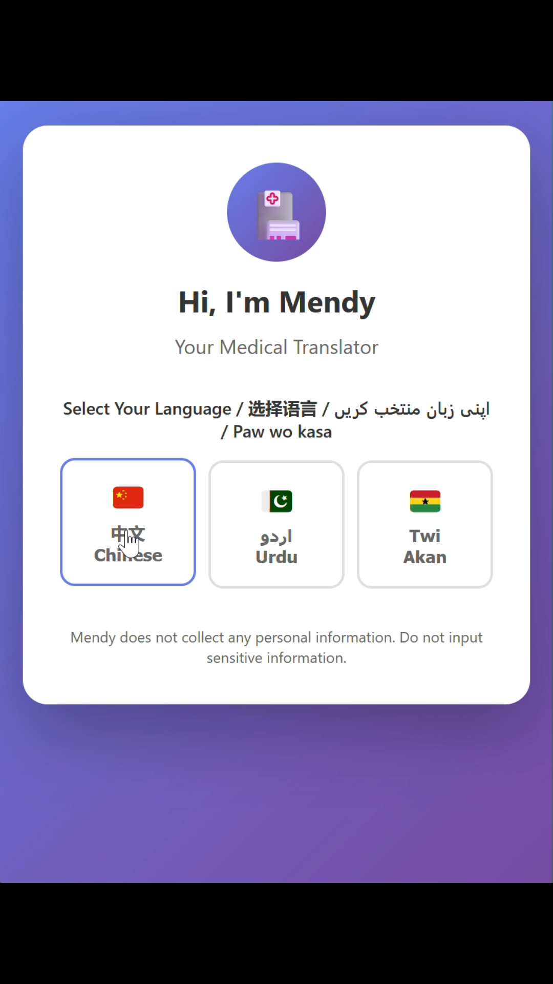
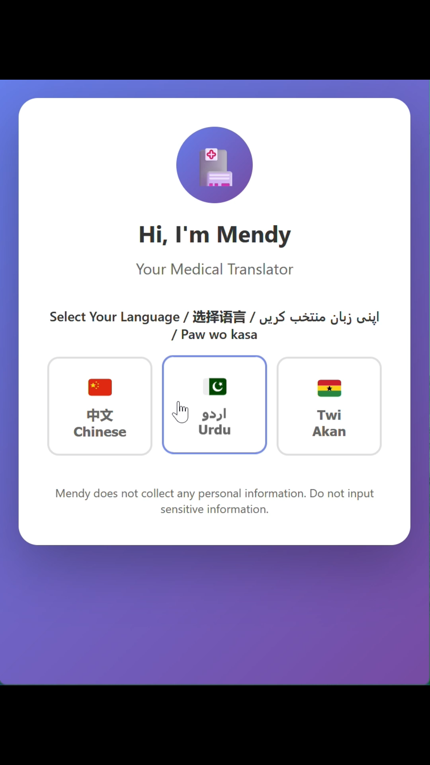
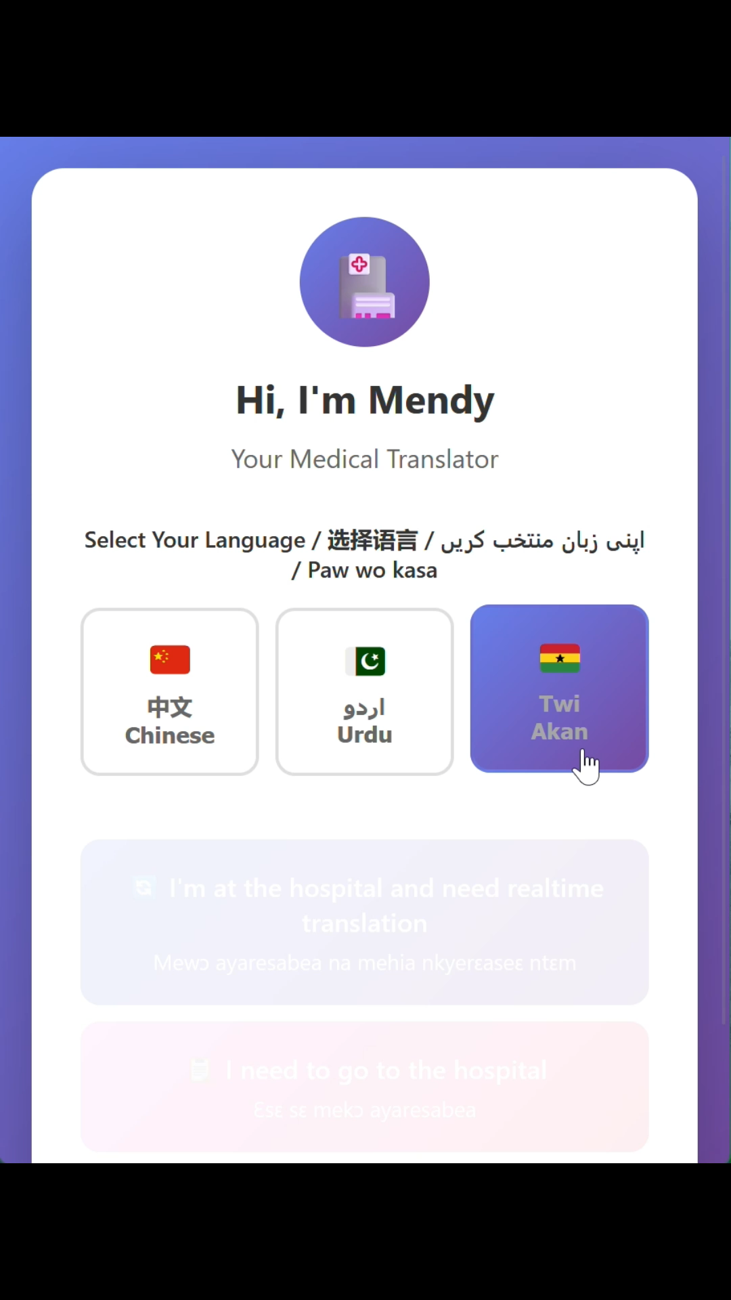
Final Version
Urdu
Twi
Chinese

Slide 3
Critical Analysis – Design Analysis
Design choice: A task-mode, workflow-first UI that splits the experience into two guided flows: Realtime Translation(when you’re already at the hospital) and Hospital Preparation (when you’re planning a visit). Each with context and role-aware, structured outputs, Gemini API (gemini-flash-latest model).
Most translators for example, Google Translate, provide a single free-form textbox and a raw translation. They don’t shape the care journey, suggest clinically useful responses, or explain what to expect from the U.S. healthcare process. Users must know what to ask next.
How Our Design Impacts Human Flourishing
Privacy & Trust
No personal info: App states “Mendy does not collect personal info; don’t input sensitive data.”
Benefit: No data retention design builds immediate trust. Especially with communities wary of sharing medical data.
Equity & Access
↑ Linguistic access: Supports languages like Twi alongside Chinese and Urdu.
Benefit: Counters systemic inequality; extends high-quality, contextualized care to communities often underserved by mass-market tools.

Slide 4
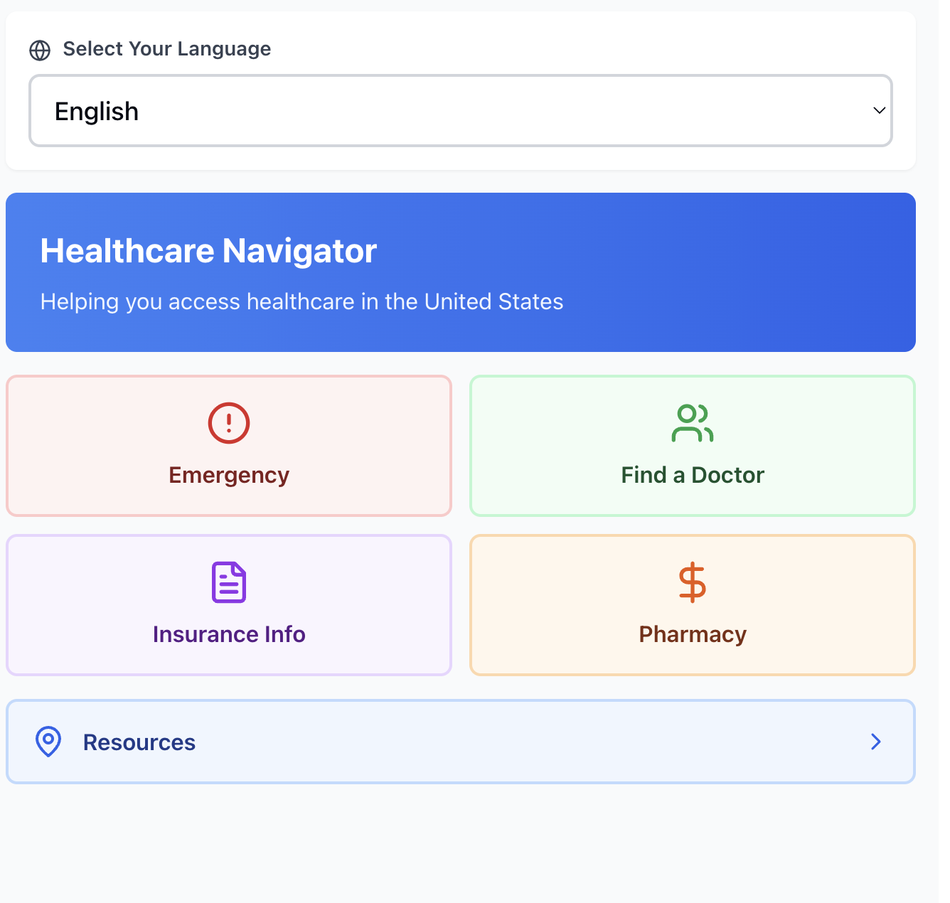
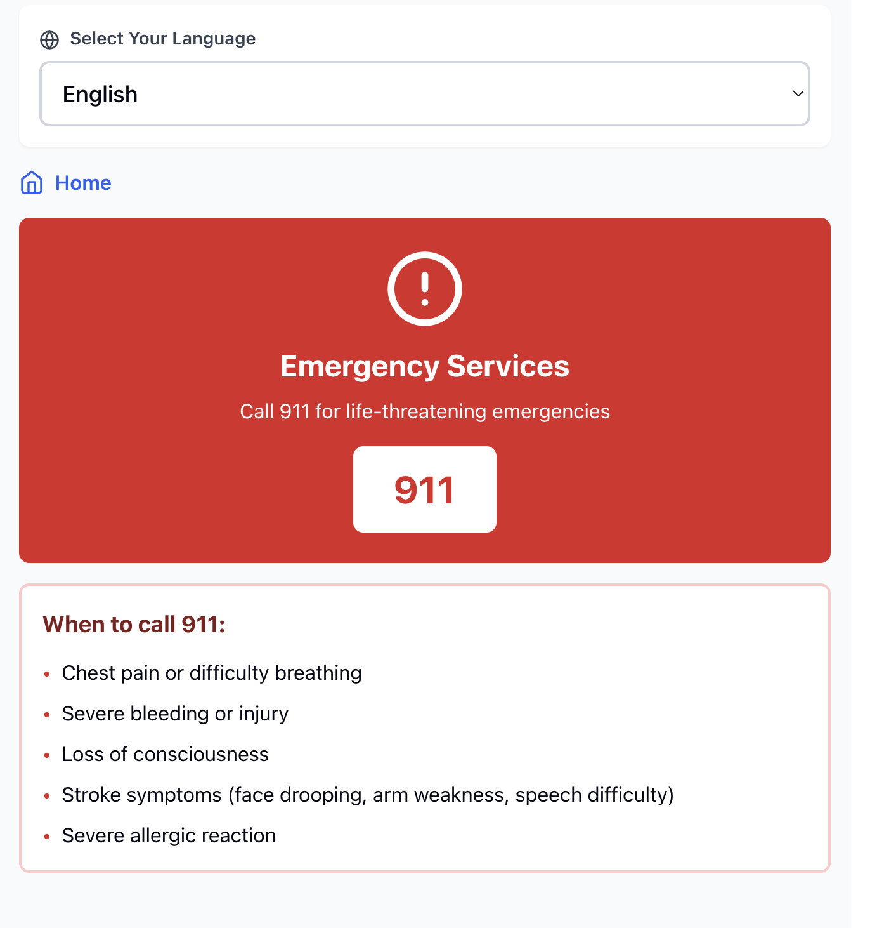
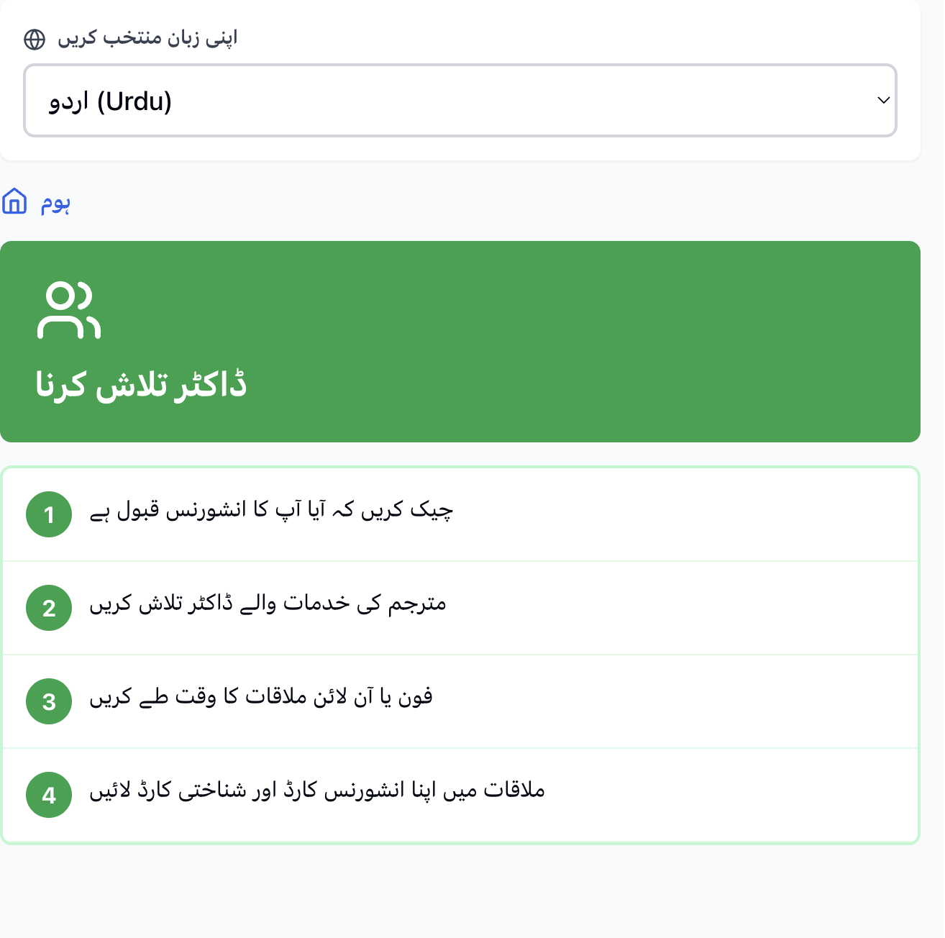
Technical Evaluation – Toy Model

Slide 5
Technical Evaluation – Systematic Testing
We wanted to make our system different than just literal translation. Unlike google translate, we wanted to provide contextual translation tailored to be used within a hospital situation. As Prof Arnold mentioned, “imagine sending your parents to a clinic here in USA, what would you want them to have?” This is why we implemented the feature “ I am at the hospital and need real time translation”.
For the backstory, “what brings a person to the hospital?”, we added another assistance feature “I need to go to the hospital”. This feature assists users in their preferred language on whether they need an appointment, what type of doctor/department they want to check in , what to expect during the visit, what to bring and any associated/expected costs.
Team members, each proficient in one language in this model, tested to see if the translation was accurate and contextual. (speed was added later)

Slide 6
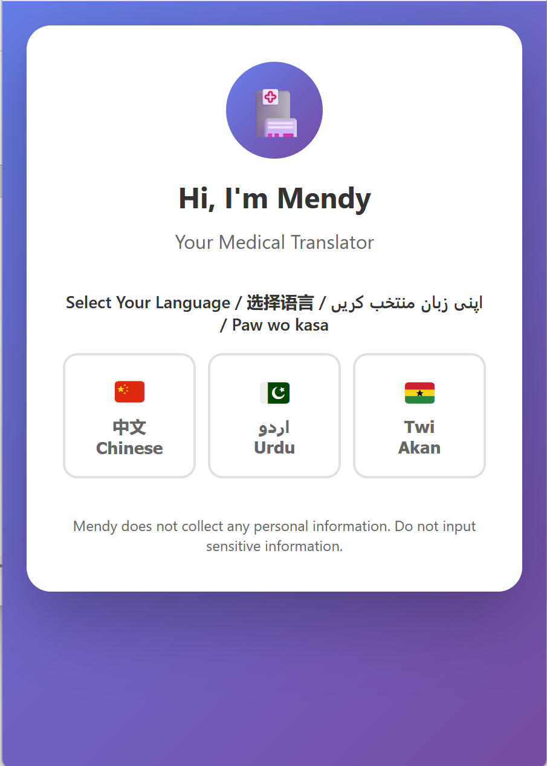
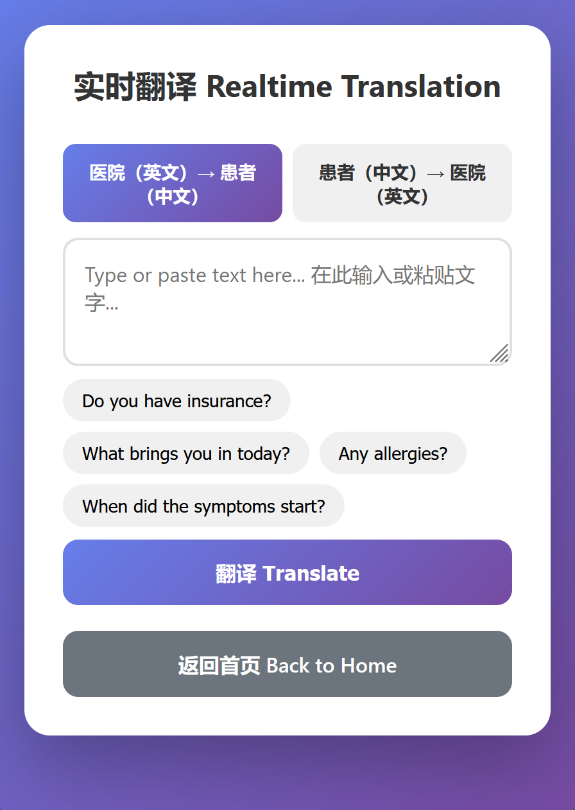
Prototype, User Testing & Iterations
Problems revealed:
High latency, waiting is awkward...
Unclear as to whether the translation is hospital to patient or patient to hospital.
Output is long, contain unnecessary material
Solutions:
Prompt engineering to make output more concise.
Implemented structured output.
Split real-time translation between two parts.
hospital -> patient
patient -> hospital
Added instruction/disclaimer about data privacy.

Slide 7
Technical Evaluation – Performance Analysis
Strengths | Limitations
Reduces the stress of initial steps in hospital preparation and navigation. Can understand a new system in one’s own language. | Our model simplifies the complexity of real hospital visits.
Simple interface. Can be used easily by anyone. | External factors such as insurance coverage, socioeconomic background, and family support are not currently integrated into the model.
No privacy issues. Our model does not take any patient information. Just a hospital communication assistant. | For the same patient, our model may not consider previous medical history which might not be not be as effective in hospital preparation.

Slide 8
Alternative Envisioning (What we could have done)
Analysis of Benefits & Drawbacks on Human
Patient Wellbeing
PATIENT WELLBEING
Benefits: Reduces visit stress; reduces power imbalance and the patient feels heard.
Drawbacks: Exclusion risk: requires a device, digital liteeacy and internet access
CLINICIAN-WORK RELATIONSHIP
Benefits: Improved efficiency (clinician is pre-informed); better focus during visit.
Drawbacks: Depersonalization—over-reliance on summary may replace rapport-building dialogue.
PRIVACY AND AGENCY
Benefits: Enhanced data control: patient authors the record before it enters the EHR.
Drawbacks: New privacy risk: full chat log becomes sensitive data; needs strict security & clear retention policy.
Feature Description
Pre-Visit Intake Chatbot: Patient inputs symptoms, medical history, and quick questions in their native language (Chinese/Urdu/Twi).
LLM Summarization: Mendy's LLM component analyzes the entire native-language conversation, summarizing it into a concise, bulleted English summary of the "Chief Complaint" and key risks (e.g., allergies, chronic conditions).
Outcome: Clinician reviews the standardized English summary before the patient arrives, allowing them to formulate a diagnostic plan and focus the in-person interaction.

Slide 9
User-Centered Design - Reflection
Our hospital translator, Mendy reflects the spirit of Human-Centered AI by embedding empathy and accessibility into healthcare communication. For people already coping with cultural shock, language barriers can make medical visits intimidating. By offering translations in Urdu, Chinese, and Twi, our tool helps patients feel more comfortable asking questions and advocating for their health. Centered on empathy and inclusion, it shows how AI can ease communication barriers and make healthcare more human.

